Slide 1
Statistical Process Control (SPC)
Nicholas Howe

Slide 2
Agenda
What is SPC?
Types of SPC Charts
Violations of Assumptions
Examples

Slide 3
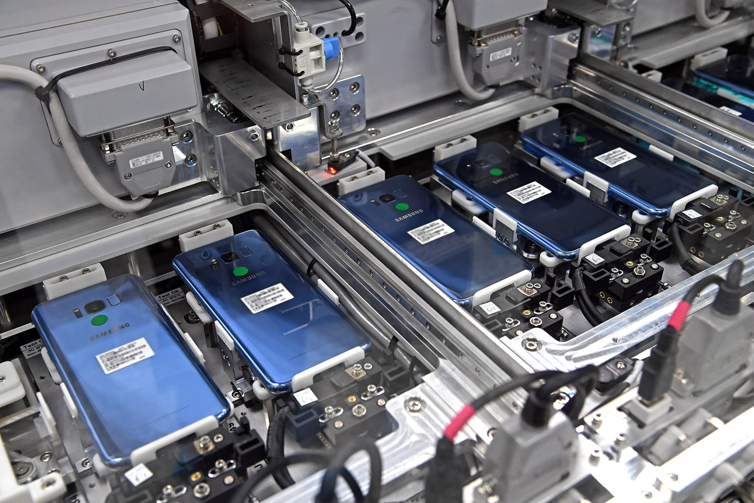
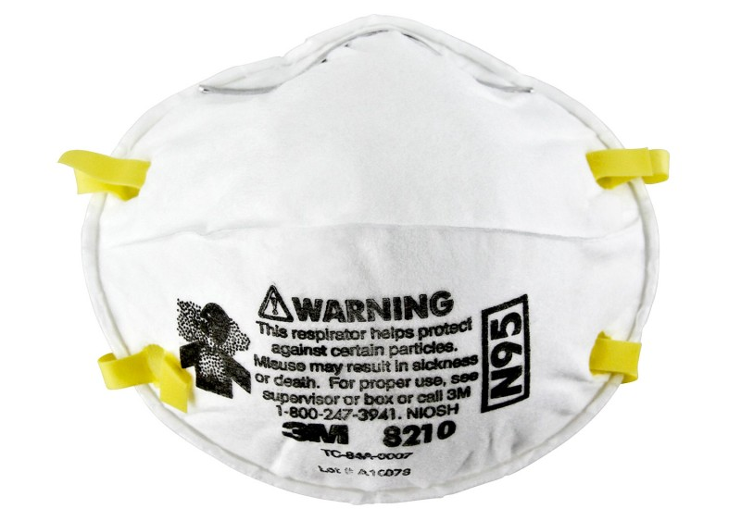
What is SPC?
To detect out of control process:
Significant change in mean
Significant change in variance
Examples:
Smartphone battery life
Particulate filtration efficiency
Quality control
Six Sigma standards
https://www.digitaltrends.com/mobile/behind-scenes-samsung-designed-built-galaxy-s8-s8/
https://www.3m.com.sg/3M/en_SG/company-sg/all-3m-products/~/3M-Particulate-Respirator-8210-N95-160-Case/?N=5002385+3294780268&rt=rud
http://multimedia.3m.com/mws/media/312703O/masks-and-respirators-tri-fold-brochure-eng.pdf

Slide 4
Types of SPC Charts

Slide 5
Types of SPC Charts
Variable
Continuous data
Attribute
Counts data
Time Weighted
Increased sensitivity to out of control process
Assumptions
Independence
Normally distributed (Optional)

Slide 6
Summary of SPC charts
Variable
$\overline{x},s$
𝑥 ̅,𝑠
$\overline{x},R$
𝑥 ̅,𝑅
Attribute
c-chart
Time Weighted
EWMA
$x, R$
𝑥, 𝑅
u-chart
Tabular Cusum
np-chart
p-chart
$s^{2}$
𝑠^2
$R$
𝑅
$s$
𝑠

Slide 7

Variable Control Charts – $x, R$ Chart
Individual observation chart

Slide 8

Attribute Control Charts – c-chart
Individual observation ($x, R$) chart

Slide 9
Time Weighted Control Charts – EWMA
Individual observation ($x, R$) chart

Slide 10
Violations of Assumptions

Slide 11
Violations of Assumptions
Violation of Independence
Autocorrelated process
Violation of Normality
Skewed distributions
Heavy-tailed distributions
Properties of Normal Distribution
Skewness = 0
Kurtosis = 3

Slide 12
Autocorrelated Process

Slide 13
Skewed distributions

Slide 14
Heavy-tailed distributions

Slide 15
Examples

Slide 16
Singapore COVID-19 Cases

Slide 17
Singapore Dengue Cases

Slide 18
Individual Blood Pressure Tracking

